Slide 1
Lightning Talk #1

Slide 2
Topic 1 : flight price predictions
problem statement:
Airfare prices vary significantly due to factors such as airline, departure time, arrival time, number of stops and more. Understanding how these factors influence ticket prices can help travelers make cost-effective decisions that can save more than $1000 or more on the traveler. This project aims to analyze the key determinants of flight prices and develop a predictive model to estimate ticket costs.

Slide 3
Data dictionary
Categorical features (8)
Numerical features (2)
duration
days_left
Airline
flight
source_city
departure_time
stops
arrival_time
destination_city
class
Target
price

Slide 4
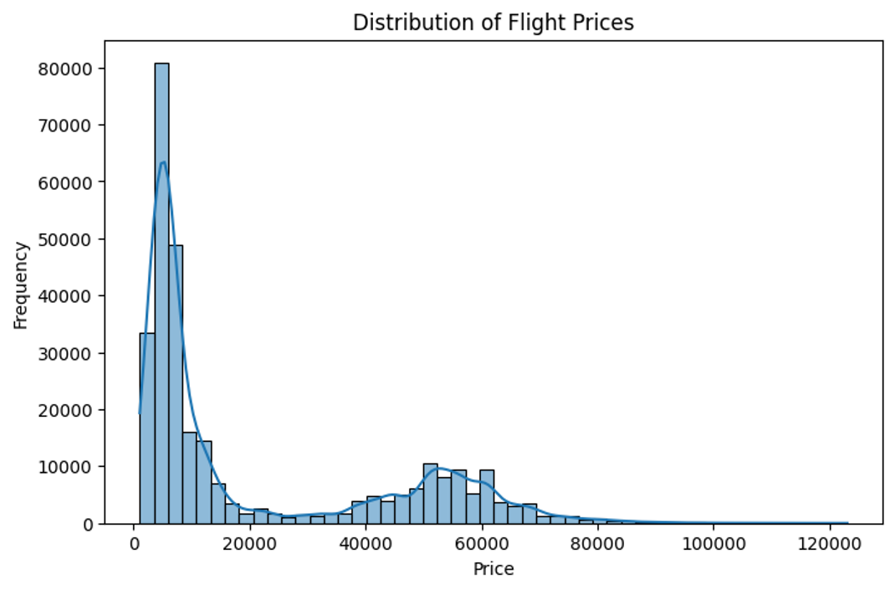
+30K records
Price
Min price:$1105
Max price:$123.07K
Mean:$20.9K
Median:$7.4K
regular prices <$100K

Slide 5
Correlations with target(price):
Numeric features:
duration 0.204222
days_left -0.091949
Duration: weak positive correlation
Days_left: not significant negative correlation

Slide 6
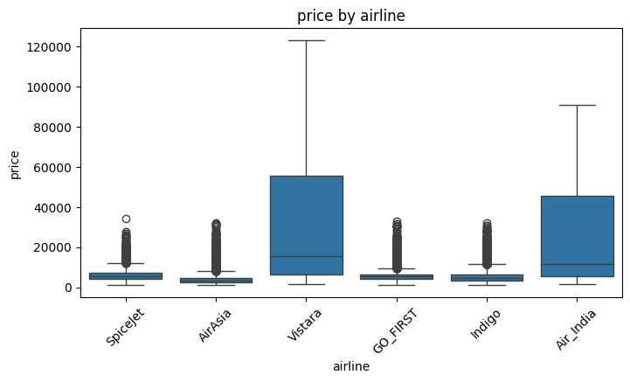
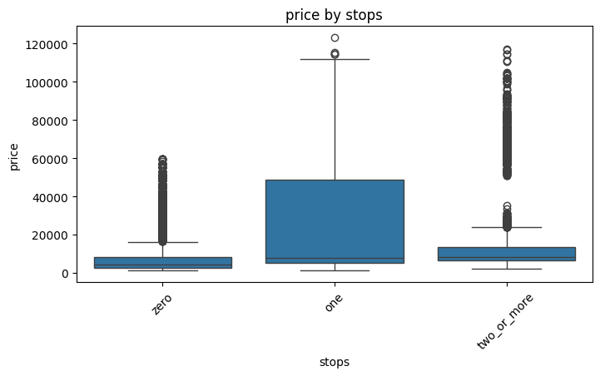
Correlations with target(price):
Categorical features:
Airline: Vistara & Air_india cost the maximum prices
Stop: if the flight has on stop it costs the maximum price

Slide 7
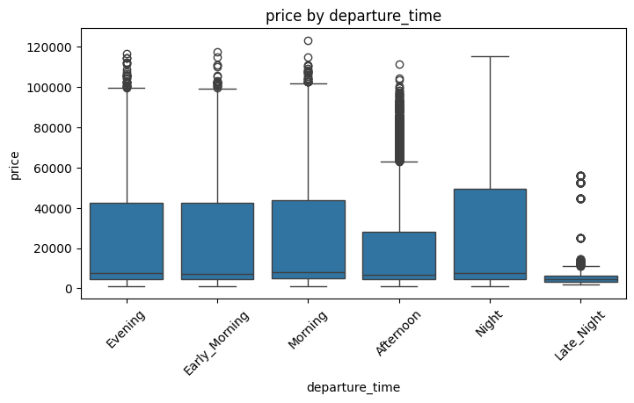
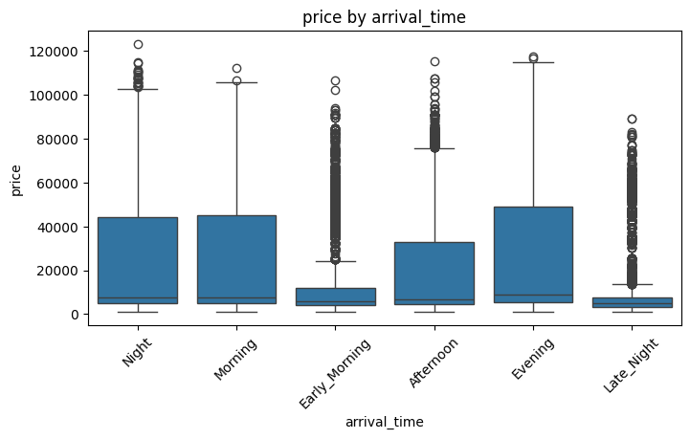
Correlations with target(price):
Categorical features:
Departure time: Late night & Afternoon cost the minimum prices
Arrival time: Late night & early morning cost the minimum prices

Slide 8
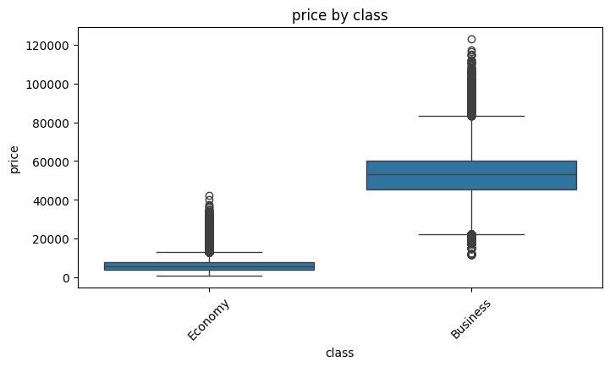
Correlations with target(price):
Categorical features:
Class: the business class is much more expensive price than the economy class

Slide 9
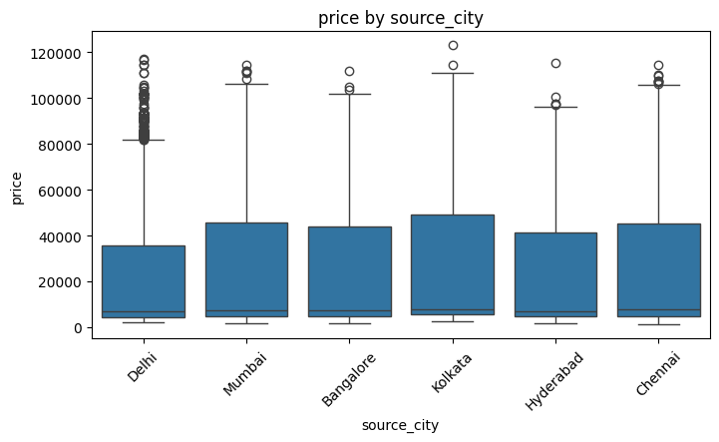
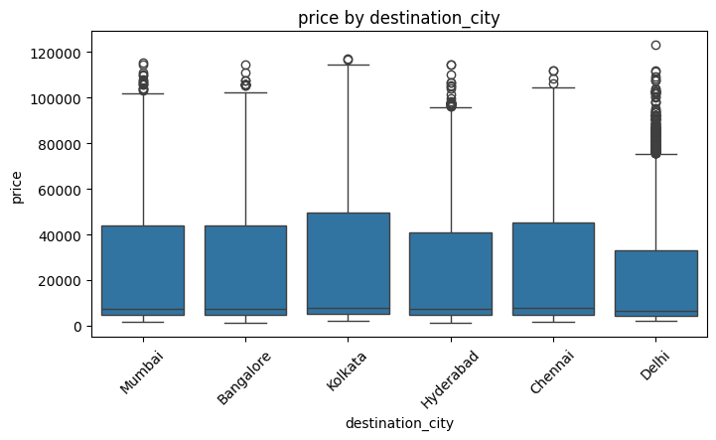
Correlations with target(price):
Categorical features:
Source and destination city factors: do not affect that much, we can see they almost have the same lower bound and the upper bound can vary a little.

Slide 10
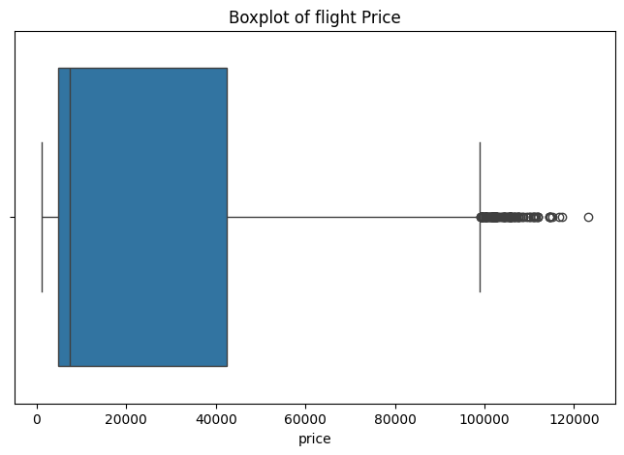
Outliers:
123 outliers
IQR = Q3 - Q1
Upper bound=$99128
The upper bound identifies high-priced tickets, as potential outliers. These values were retained because they represent valid premium pricing rather than data errors.

Slide 11
Topic 2 : work productivity
problem statement:
The widespread availability of internet access and digital technologies has enabled many organizations to adopt remote work arrangements. While remote work can reduce operational costs and increase flexibility for both employers and employees, its impact on employee productivity remains an important area of study. Organizations need to understand which demographic, work-related, and well-being factors influence productivity in work environments. This project will capture the main factors affect employee productivity to guide employers support positive factors and eliminate or minimize the effect of negative ones.

Slide 12
Data dictionary
Categorical features(4)
Numerical features(9)
Age
year
tasks_completed
sleep_hours_avg
exercise_frequency_per_week
mental_health_score
salary_usd
weekly_hours_worked
burnout_level
Country
Industry
work_mode
burnout_level
Target
productivity_score

Slide 13
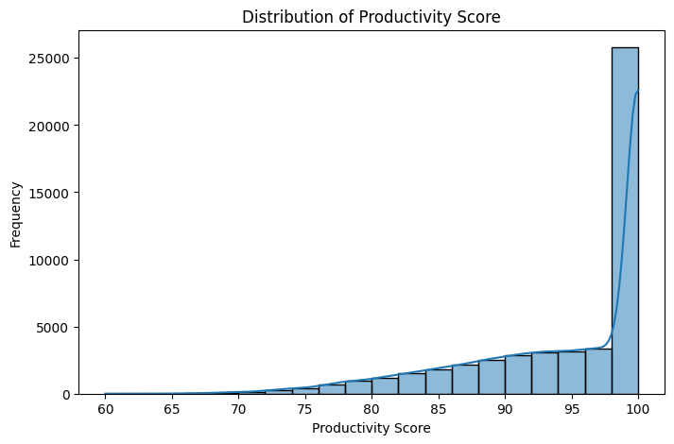
50K records
productivity_score
Min productivity_score: 60
Max productivity_score: 100
Mean:$94.4
Median:$98

Slide 14
Correlations with target (productivity_score):
mental_health_score | 0.713322
sleep_hours_avg | 0.576854
job_satisfaction | 0.562137
tasks_completed | 0.548097
age | 0.002194
salary_usd | 0.003038
exercise_frequency_per_week | -0.003098
year | -0.004457
weekly_hours_worked | -0.556147
most correlated features
possitively correlated
mental_health_score about 0.71 with the target
sleep_hours_avg around 0.58
job_satisfaction around 0.56
tasks_completed around 0.55
negativly correlated
weekly_hours_worked : around -0.56

Slide 15
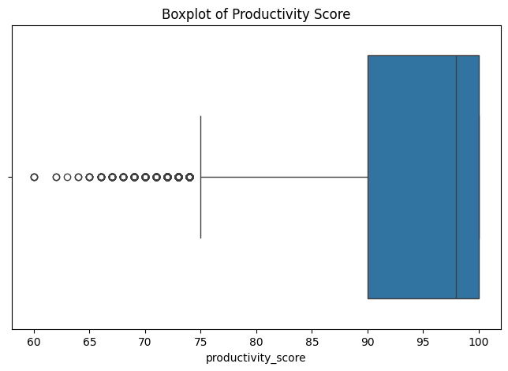
Outliers:
728 outliers
IQR = Q3 - Q1
lower bound=75
Values below 75 were flagged as potential outliers but retained, as they likely reflect genuine low-productivity cases. With only 728 outliers in a dataset of 50,000 records, their impact is expected to be minimal, though robust modeling or scaling techniques may be used if necessary.

Slide 16
Thank
You

